Slide 1








Data Analysis Portfolio
Prepared By:- Harsh Shukla

Slide 2

Table Of Contents
Professional Summary-------------------------------------------------------------(3)
Key Skills-------------------------------------------------------------------------------(4)
Professional Experience---------------------------------------------------------(5-6)
Instagram User Analytics------------------------------------------------------(7-15)
Operation Analytics and Investigating ----------------------------------(16-26)
Hiring Process Analytics------------------------------------------------------(27-33)
Bank Loan Case Study--------------------------------------------------------(34-49)
Impact of Car Features on Price and Profitability----------------------(50-57)
ABC Call Volume Trend Analysis-------------------------------------------(58-66)
IMDB Movie Analysis --------------------------------------------------------(67-73)
Summary-----------------------------------------------------------------------------(74)

Slide 3




Professional Summary:
Dedicated and adaptable recent MCA graduate with a strong foundation in data analysis, Python, Power BI, Tableau, and SQL. Complemented by a bachelor's degree in Computer Applications (BCA), I am eager to apply my theoretical knowledge to real-world corporate challenges and expand my skillset. My academic coursework, coupled with internship experiences, has provided me with valuable insights into the data analytics field.

Slide 4
Key Skills:
Data Analysis: Proficient in analyzing data to derive meaningful insights and support decision-making processes.
Python: Skilled in using Python for data manipulation, visualization, and scripting.
Data Visualization: Capable of creating compelling visualizations using tools like Power BI and Tableau.
SQL: Competent in managing and querying databases to extract and manipulate data.
Recruitment Experience: Prior exposure to the US-IT recruitment field, which has honed my interpersonal and communication skills.

Slide 5
Professional Experience:
US-IT Recruiter (Resource Consulting Services)
As a US-IT Recruiter, I gained valuable exposure to the dynamic world of talent acquisition. This role refined my communication and negotiation skills as I interacted with candidates and clients. I learned the importance of understanding business needs and matching them with the right talent, which will be a valuable asset in my future endeavors in data analysis.

Slide 6
Professional Experience:
Data Analyst (Accenture - Online Internship)
During my online internship at Accenture, I had the opportunity to apply my data analysis skills in a corporate environment. I collaborated with senior data analysts to process, clean, and visualize data sets. This experience enhanced my practical knowledge of tools like Power BI and Tableau, and I got hands-on experience in using SQL for data extraction.

Slide 7


In this project we are doing an in-depth exploration of user interactions and engagement with the Instagram app. we aim to unearth insights that catalyse informed decision-making across various business functions.
We are going to achieve this by doing these tasks:
Marketing Analysis
Investor Matrics
Project Recap
Instagram User Analytics

Slide 8
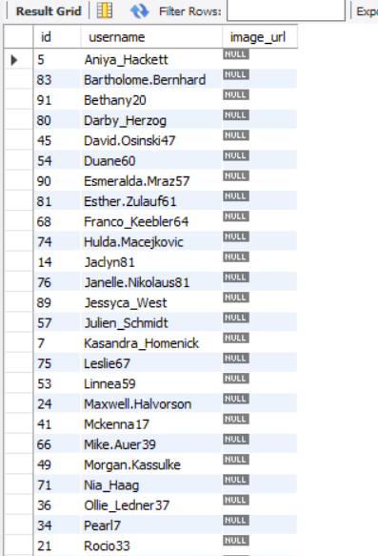
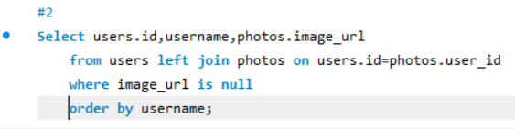
Marketing Analysis
Inactive User Engagement:-
The team wants to encourage inactive users to start posting by sending them promotional emails.

Slide 9
Marketing Analysis
Inactive User Engagement:-
The team wants to encourage inactive users to start posting by sending them promotional emails.

Slide 10
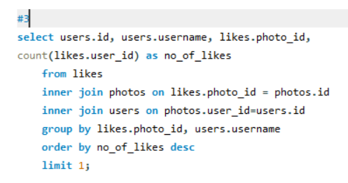
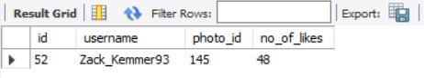
Marketing Analysis
Contest Winner Declaration:-
The team has organized a contest where the user with the most likes on a single photo wins.

Slide 11
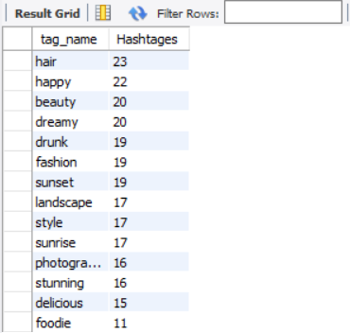
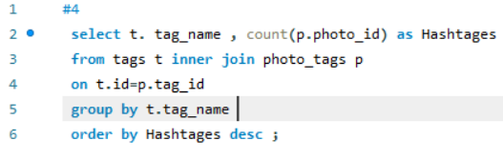
Marketing Analysis
Hashtag Research:-
A partner brand wants to know the most popular hashtags to use in their posts to reach the most people.

Slide 12
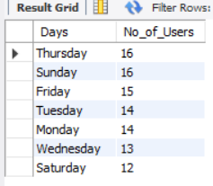
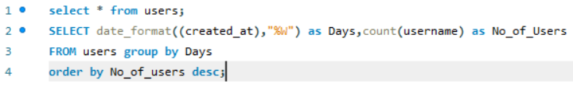
Marketing Analysis
Ad Campaign Launch:-
The team wants to know the best day of the week to launch ads.

Slide 13
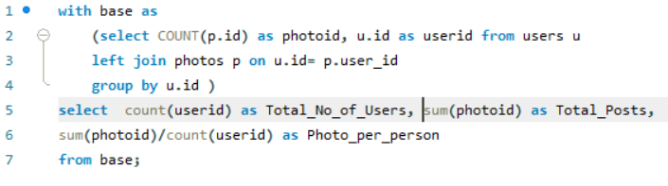
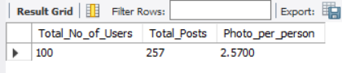
Investor Metrics
User Engagement:-
Investors want to know if users are still active and posting on Instagram or if they are making fewer posts..

Slide 14
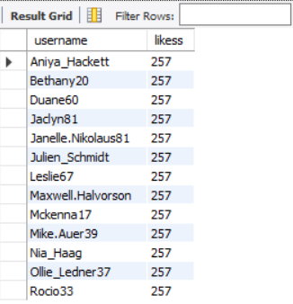
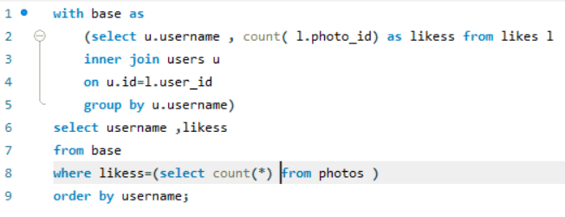
Investor Metrics
Bots & Fake Accounts:-
Investors want to know if the platform is crowded with fake and dummy accounts.

Slide 15
Insights
Remarkable revelation through meticulous data analysis: 'ZACK_KEMMER97' has the highest number of likes on a single post.
Predominant use of tags by users: 'Hair,' 'Happy,' 'Beauty,' 'Dreams,' and 'Drunk.'
Proposal: Foster user engagement through events centered around these themes.

Slide 16
In this project we are doing an in-depth exploration of Operation Analytics and Investigating Metric Spike for the company. we aim to unearth insights that catalyse informed decision-making across various business functions.
In this project, two case studies need to be undertaken:
Case Study 1: Job Data Analysis
Case Study 2: Investigating Metric Spike
Project Recap
Operation Analytics
and Investigating
Metric Spike

Slide 17
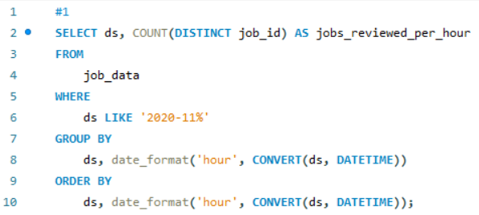
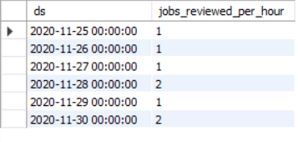
Case Study 1: Job Data Analysis
Jobs Reviewed Over Time:-
Calculate the number of jobs reviewed per hour for each day in November 2020.

Slide 18
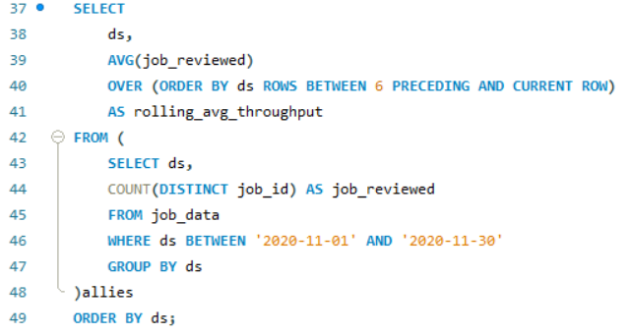
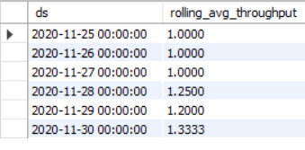
Case Study 1: Job Data Analysis
Throughput Analysis:-
Calculate the 7-day rolling average of throughput (number of events per second).
Why:- Opting for a 7-day rolling average proves advantageous by smoothing out fluctuations, revealing long-term patterns, and minimizing noise caused by outliers. This approach provides a clearer and more reliable insight into overall trends while reducing the impact of temporary anomalies.

Slide 19
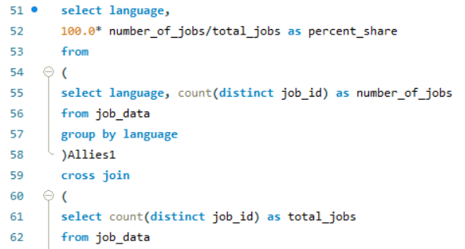
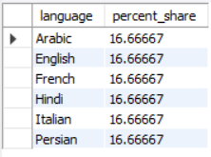
Case Study 1: Job Data Analysis
Language Share Analysis:-
Calculate the percentage share of each language in the last 30 days.

Slide 20
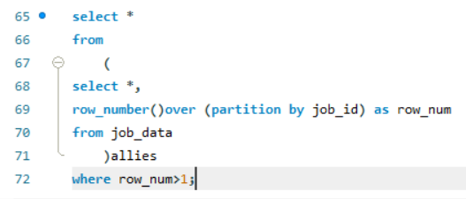
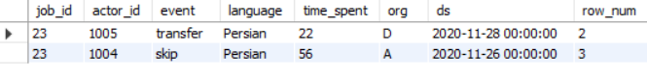
Case Study 1: Job Data Analysis
Duplicate Rows Detection:-
Identify duplicate rows in the data..

Slide 21
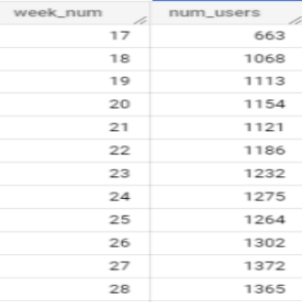
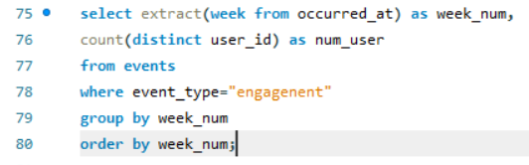
Case Study 2: Investigating Metric Spike
Weekly User Engagement:-
Measure the activeness of users on a weekly basis.

Slide 22
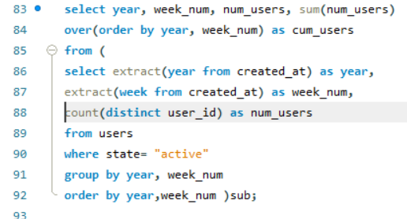
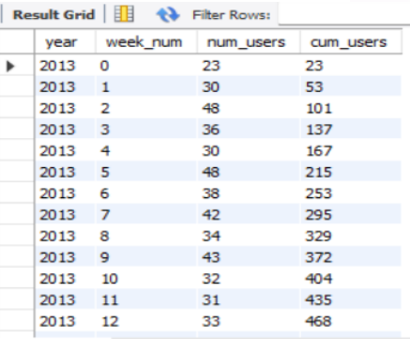
Case Study 2: Investigating Metric Spike
User Growth Analysis:-
Analyze the growth of users over time for a product.

Slide 23
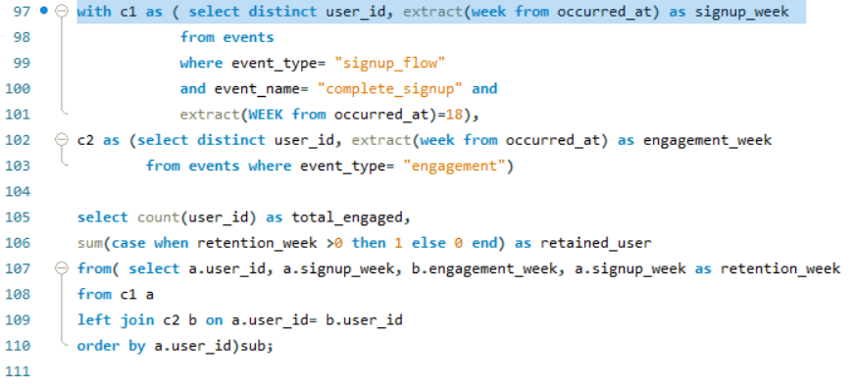
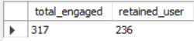
Case Study 2: Investigating Metric Spike
Weekly Retention Analysis:-
Analyse the retention of users on a weekly basis after signing up for a product.

Slide 24
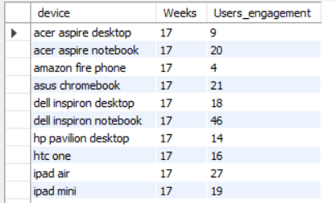
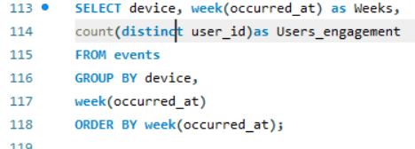
Case Study 2: Investigating Metric Spike
Weekly Engagement Per Device:-
Measure the activeness of users on a weekly basis per device.

Slide 25
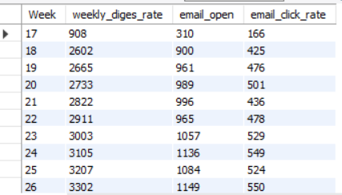
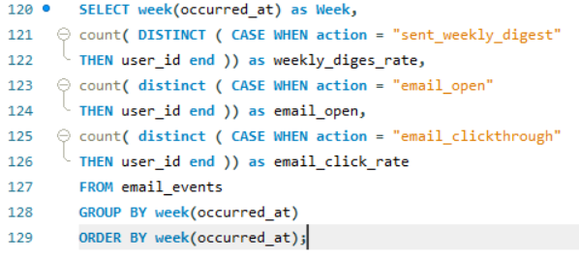
Case Study 2: Investigating Metric Spike
Email Engagement Analysis:-
Analyze how users are engaging with the email service.

Slide 26
Insights
Remarkable revelation through meticulous data analysis: Persian Language has the highest share among other languages.
User engagement peak at 31st - "Macbook Pro" users have the highest user engagement.
Proposal: Foster user engagement through events centered around these themes.

Slide 27
As a Data Analyst for our current company . Today, our task is to analyze data related to our hiring process. We aim to extract meaningful insights from this data, such as the average salary, the number of male and female hires, and the most popular salary range among our new hires.
Project Recap
Hiring Process Analytics

Slide 28
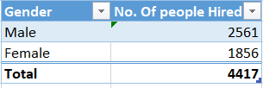
Hiring Analysis:-
The hiring process involves bringing new individuals into the organization for various roles.

Slide 29
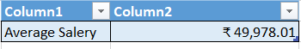
Salary Analysis:-
The average salary is calculated by adding up the salaries of a group of employees and then dividing the total by the number of employees.

Slide 30
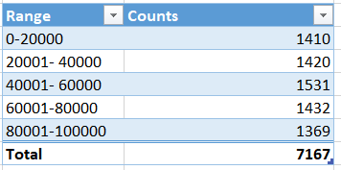
Salary Distribution:-
Class intervals represent ranges of values, in this case, salary ranges. The class interval is the difference between the upper and lower limits of a class

Slide 31
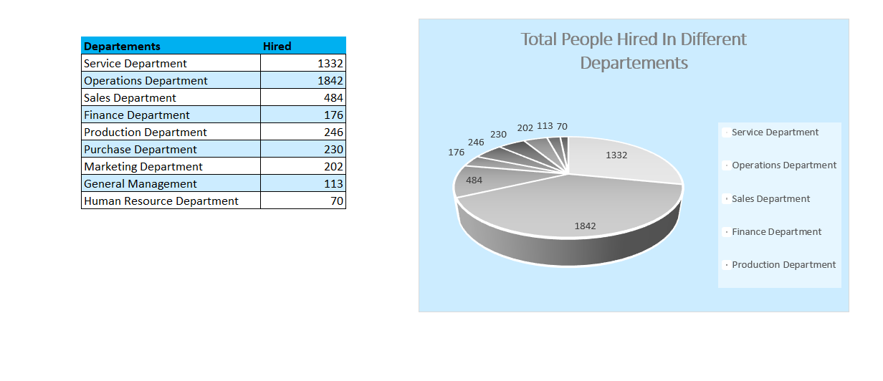
Departmental Analysis:-
Visualizing data through charts and plots is a crucial part of data analysis.

Slide 32
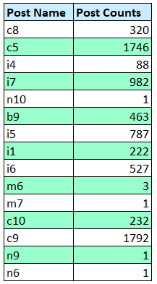
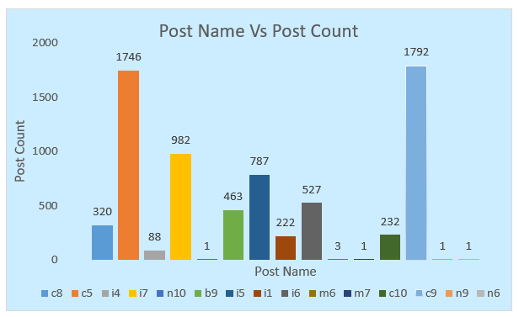
Position Tier Analysis:-
Different positions within a company often have different tiers or levels.

Slide 33

Insights
It appears that in our current hiring data, there are approximately 37.6 more males hired than females. Specifically, you've hired 2,561 males and 1,856 females.
According to the current data, the majority of candidates we hired fall within the salary range of 40,000 to 60,000, with approximately 1,531 candidates falling within this range.
The majority of hires are from the Operations department, with a total of 1,842 candidates. The Service Department follows closely behind with 1,332 hires.
2561
1531
1842

Slide 34
The main aim of this project is to identify patterns that indicate if a customer will have difficulty paying their installments. This information can be used to make decisions such as denying the loan, reducing the amount of loan,or lending at a higher interest rate to risky applicants. The company wants to understand the key factors behind loan default so it can make better decisions about loan approval.
Project Recap
Bank Loan Case Study

Slide 35
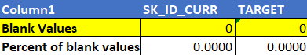
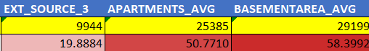
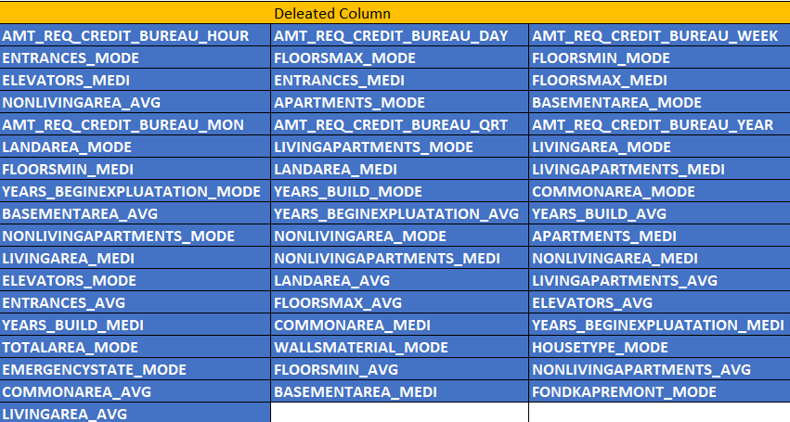
Identify Missing Data and Deal with it Appropriately.
Identify the missing data in the dataset and decide on an appropriate method to deal with it using Excel built-in functions and features
(Number Of Blank Values is each Column)
(Deleted Columns)

Slide 36
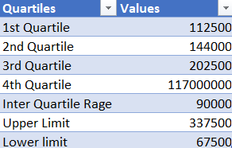
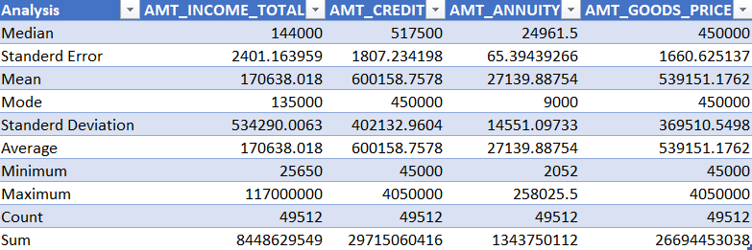
Identify Outliers in the Dataset.
Detect and identify outliers in the dataset using Excel statistical functions and features, focusing on numerical variables.
(Quartile Values Of AMT_INCOME_TOTAL)
(Statistical Analysis)

Slide 37
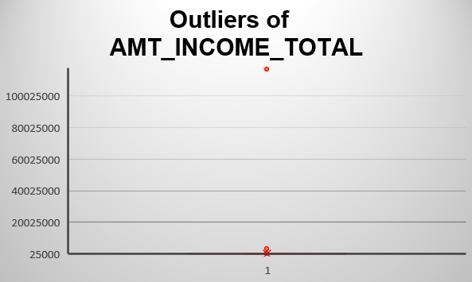
Identify Outliers in the Dataset.
When examining the chart, we have identified a noteworthy outlier in the variable "AMT_Income_Total," with an income value reaching as high as 117,000,000. This exceptionally high income figure clearly stands out as an outlier within the dataset

Slide 38
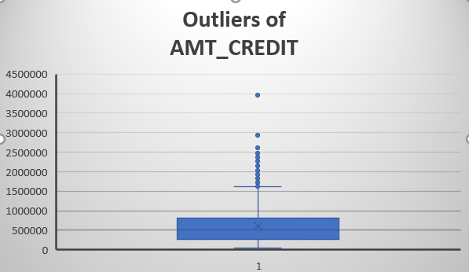
Identify Outliers in the Dataset.
Upon analyzing the box plot chart for the variable "AMT_Credit," it has become evident that there is another outlier, specifically an AMT_Credit value of 3,956,274. Similar to the previous case, this value stands out significantly from the majority of data points in the dataset, indicating its status as an outlier.

Slide 39
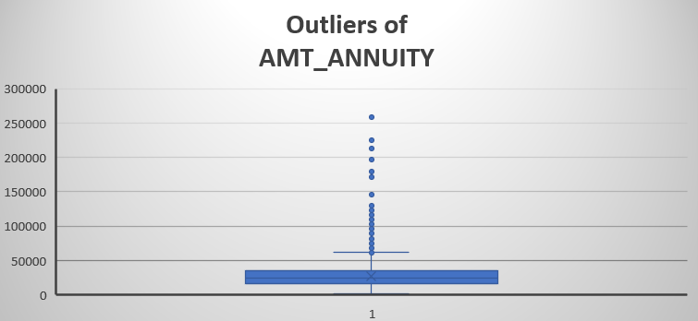
Identify Outliers in the Dataset.
In the chart depicting "AMT_annuity," there are noticeable outliers, such as the values 258,025 and 225,000. These values significantly deviate from the typical range of data points in the dataset, indicating their status as outliers.

Slide 40
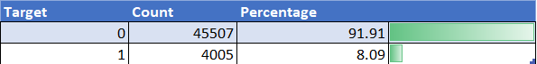
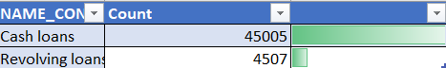
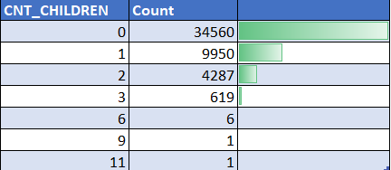
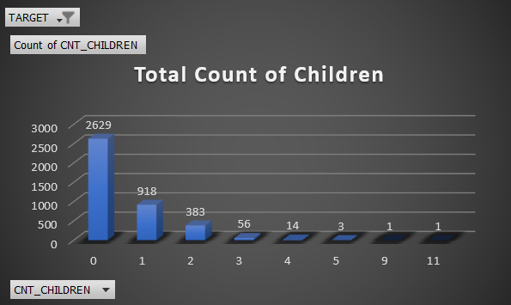
Analyse Data Imbalance:
Determine if there is data imbalance in the loan application dataset and calculate the ratio of data imbalance using Excel functions.
(Imbalance In Total Request Accept)
(Imbalance In Loan Type)
(Imbalance in Children Count)
(Accepted Request Count)

Slide 41
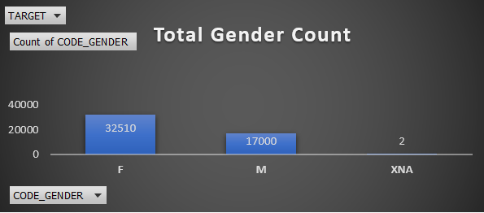
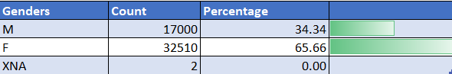
Analyse Data Imbalance:
The chart displays the difference in the total number of loan requests between females and males, indicating varying request patterns among genders. This insight can inform strategies to better cater to the needs of both groups.
(Imbalance in Request Gender wise)

Slide 42


Perform Univariate, Segmented Univariate, and Bivariate Analysis:
The chart below presents a Bivariate analysis comparing various income ranges with the average AMT_Credit (credit amount) values. This analysis allows us to explore how different income groups correlate with the average loan amounts requested or granted. Such insights can be valuable for understanding the relationship between income levels and loan sizes in a given dataset.
(Bivariate Analysis)

Slide 43
Perform Univariate, Segmented Univariate, and Bivariate Analysis:
The chart below presents a Bivariate analysis comparing various income ranges with the average AMT_Credit (credit amount) values. This analysis allows us to explore how different income groups correlate with the average loan amounts requested or granted. Such insights can be valuable for understanding the relationship between income levels and loan sizes in a given dataset.
(Bivariate Analysis)

Slide 44


Perform Univariate, Segmented Univariate, and Bivariate Analysis:
The chart provided below represents a univariate analysis of the distribution of SK_ID_CURR counts across various credit ranges.
(Univariate Analysis)

Slide 45


Perform Univariate, Segmented Univariate, and Bivariate Analysis:
The chart presented below illustrates a segmented univariate analysis that breaks down the count of SK_ID_CURR into different income ranges while also considering the Target values of 0 and 1. This type of analysis helps us understand how the distribution of SK_ID_CURR counts varies across income ranges for both Target values 0 and 1.
(Segmented Univariate Analysis)

Slide 46

Dashboard:-
(Dashboard to Demonstrate the Analysis)

Slide 47

Identify Top Correlations for Different Scenarios:
Segment the dataset based on different scenarios (e.g., clients with payment difficulties and all other cases) and identify the top correlations for each segmented data using Excel functions.
(Top Correlation of Target Value 0)

Slide 48

Identify Top Correlations for Different Scenarios:
Segment the dataset based on different scenarios (e.g., clients with payment difficulties and all other cases) and identify the top correlations for each segmented data using Excel functions.
(To Correlation of Target Value 1)

Slide 49
Insights
After conducting our analysis, we've observed that a larger number of female clients tend to apply for loans compared to their male counterparts of around 32510. However, it's noteworthy that a substantial portion of loan requests from female clients, approximately 30,260 in total, are experiencing rejection.
Our analysis has revealed a significant trend: clients who have zero children are the most frequent applicants for loans, with a notable count of 34,560 applications falling into this category.
Individuals residing in Region Rating 3 exhibit the highest percentage of loan defaults, which suggests that the bank should consider implementing stricter loan policies for clients hailing from this region. Conversely, clients originating from Region 1 appear to be the most reliable and trustworthy in terms of loan repayment.
Data sheet:-

Slide 50
The automotive industry is undergoing rapid transformation, with a shift towards fuel efficiency, environmental sustainability, and technological innovation. As a Data Analyst, our goal is to help a car manufacturer maximize profitability while meeting consumer demand.
We will analyze a comprehensive dataset encompassing car features, market categories, and pricing. Our analysis will focus on understanding the factors that drive consumer demand and profitability. We will employ data analysis techniques, including regression analysis and market segmentation
Project Recap
Impact of Car Features on Price and Profitability

Slide 51


How does the popularity of a car model vary across different market categories?
Result:-
Based on the analysis of the data, it has been identified that the following car categories have the highest popularity among consumers:- “Hatchback, Flex Fuel” “Flex Fuel,Diesel Crossover”, ”Flex Fuel, Performance”.

Slide 52

What is the relationship between a car's engine power and its price?
Result:-
The analysis indicates a positive correlation between a car's horsepower (HP) and its price, implying that higher HP leads to higher prices in the market.

Slide 53


Which car features are most important in determining a car's price?
After doing the regression analysis on the data we found the above result.

Slide 54

Which car features are most important in determining a car's price?
Result:-
The regression analysis findings reveal that the number of cylinders in the engine has the most significant impact on a car's price, followed by mileage and then horsepower. This insight can guide the car manufacturer in prioritizing these factors when setting prices and developing future models.

Slide 55


How does the average price of a car vary across different manufacturers?
Result:-
Based on the analysis of manufacturers and their average selling rates for cars, it has been determined that Bugatti has the highest average selling rate, followed by Maybach and Rolls-Royce in descending order.

Slide 56


What is the relationship between fuel efficiency and the number of cylinders in a car's engine?
Result:-
Analysis reveals a negative correlation between fuel efficiency and the number of engine cylinders, indicating that as cylinder count increases, efficiency decreases. The calculated correlation coefficient supports this inverse relationship, offering insights for engine design decisions.

Slide 57
Insights
After data analysis, it's clear that Hatchback, Flex Fuel is the most popular category, and it's notable that market categories featuring Flex Fuel tend to have high popularity among consumers.
The engine with the highest horsepower (HP) at 1001 is associated with an average MSRP of $1,757,224.
Vehicles with manual transmission are typically cheaper than those with automated manual transmission systems.
Bugatti's MSRP is the highest compared to other car makers, reflecting its premium positioning in the market.
There appears to be an outlier in the data where a 4-cylinder engine achieves the highest highway MPG of 354, which is unusually high compared to other data points.
Data sheet:-

Slide 58
This project centers on Customer Experience (CX) analytics, with a specific focus on the inbound calling team within a company. You'll work with a 23-day dataset containing agent details, queue times, call times, call durations, and call statuses (abandoned, answered, transferred).
Project Recap
ABC Call Volume Trend Analysis

Slide 59


Average Call Duration:-
Identify the missing data in the dataset and decide on an appropriate method to deal with it using Excel built-in functions and features
(Average Call Duration within Specific Time Bucket)

Slide 60

Call Volume Analysis:-
Visualize the total number of calls received. This should be represented as a graph or chart showing the number of calls against time. Time should be represented in buckets (e.g., 1-2, 2-3, etc.).

Slide 61


Call Volume Analysis:-
(Visual Representation of Number of calls & and there Percentage)

Slide 62

Manpower Planning:-
What is the minimum number of agents required in each time bucket to reduce the abandon rate to 10%?
(Needed for 90 Perc of Answered Calls)

Slide 63

Manpower Planning:-
Assumptions: An agent works for 6 days a week; On average, each agent takes 4 unplanned leaves per month; An agent's total working hours are 9 hours, out of which 1.5 hours are spent on lunch and snacks in the office. On average, an agent spends 60% of their total actual working hours (i.e., 60% of 7.5 hours) on calls with customers/users. The total number of days in a month is 30.

Slide 64

Night Shift Manpower Planning:-
Propose a manpower plan for each time bucket throughout the day, keeping the maximum abandon rate at 10%.
(Needed for 90 Perc of Answered Calls)

Slide 65

Night Shift Manpower Planning:-
(Average number of calls Abandon, Received and Transferred)
(Needed for 90 Perc of Answered Calls)

Slide 66
Insights
The data analysis shows that between 11:00 AM and 12:00 PM, there were 14,626 calls, constituting 12.40% of the total call volume, making it the busiest time slot for incoming calls.
To achieve a 90% answer rate for calls between 9:00 AM and 9:00 PM, you would need to add 255 more hours of call duration answered and employ 75 more agents.
To achieve a 90% answer rate for calls between 9:00 PM and 9:00 AM, you would need to add 75 more hours of call duration answered and employ 17 more agents. This increase in call duration and staffing levels during the night shift will help improve the answer rate and ensure more calls are attended to within that time frame.
9Am -9PM
Hours Needed:- 255
Agents Needed:- 75
9PM-9AM
Hours Needed:- 76
Agents Needed:- 17
Worksheets

Slide 67
In the scope of this project, we are tasked with conducting a comprehensive analysis
of IMDb's Movies dataset spanning the years 1927 to 2016. Our objective is to extract valuable insights from this dataset
through a series of structured tasks and analyses.
In addition to the analytical tasks, we will leverage various visualization techniques to effectively communicate our findings in a clear and easily understandable manner.
Project Recap
IMDB Movie Analysis

Slide 68





Movie Genera Analysis:-
Determine the most common genres of movies in the dataset. Then, for each genre, calculate descriptive statistics (mean, median, mode, range, variance, standard deviation) of the IMDB scores.

Slide 69



Movie Duration Analysis:-
Analyze the distribution of movie durations and identify the relationship between movie duration and IMDB score.

Slide 70



Language Analysis:-
Determine the most common languages used in movies and analyze their impact on the IMDB score using descriptive statistics.
(Languages with Highest Average IMDB Score.)
(Languages with least Average IMDB Score.)

Slide 71



Director Analysis:-
Identify the top directors based on their average IMDB score and analyze their contribution to the success of movies using percentile calculations.
(Top 10 Director’s with Highest Average IMDB Score.)

Slide 72



Budget Analysis:-
Analyze the correlation between movie budgets and gross earnings, and identify the movies with the highest profit margin.
(Top 10 Most Profited Movies.)

Slide 73



Insights
After conducting our analysis, we have determined that the movie 'Avatar' stands out as the most profitable film in the period spanning 1927 to 2016, with an impressive profit of approximately 523,505,847 dollars. It is followed by 'Jurassic World' in the second position and 'Titanic' in the third position in terms of profitability.
Upon thorough data analysis, it has been determined that the most popular movie genre is 'Comedy' specifically 'Comedy | Drama | Romance,' which boasts a popularity score of 147. This is followed closely by the genre ‘Crime | Drama | Thriller’.
523505847
Datasheet:-
147

Slide 74

I am enthusiastic about transitioning into a career in data analysis, where I can harness my skills to uncover insights that drive business decisions. As a fresher, I am eager to tackle real-world challenges and expand my practical expertise. I am committed to ongoing learning and development, and I believe that with dedication and hard work, I can make meaningful contributions to any organization I join.
As I’m perusing MCA , I am well-prepared to embark on a career in data analysis. My strong academic foundation, coupled with my internship experiences and willingness to learn, make me a versatile and promising candidate in the corporate world. I look forward to applying my skills and knowledge to tackle the challenges that lie ahead and contribute to the success of any team or organization I become a part of.
Summary

